Slide 1

AE668 : Computation Aeromechanics and Control of UAV
Individual Project
Dharshan S Hegde
M.Tech UAS - 241010078
dharshans24@iitk.ac.in

Slide 2
Design of light-weight tricopter for surveillance operation

Slide 3
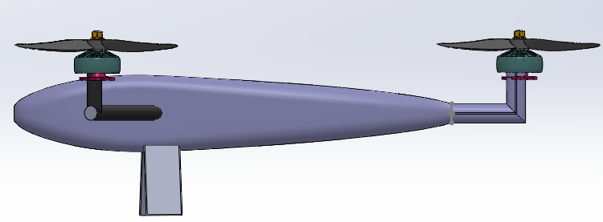
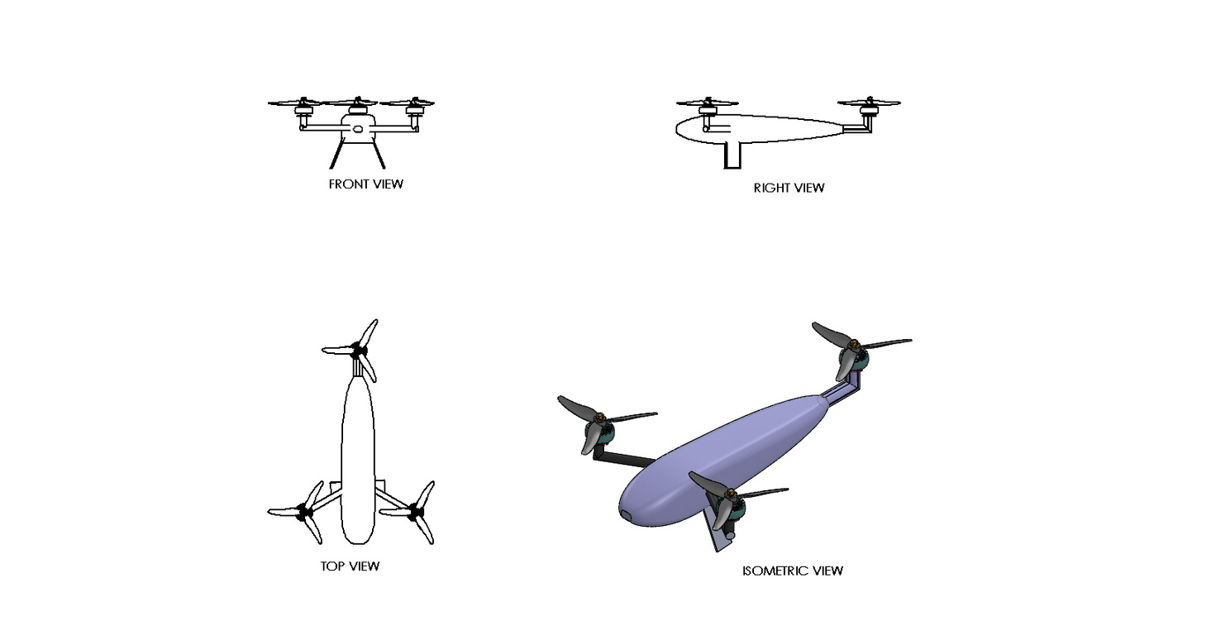
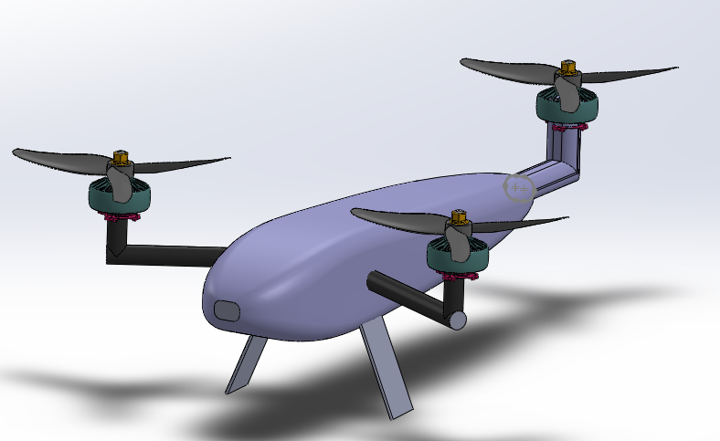
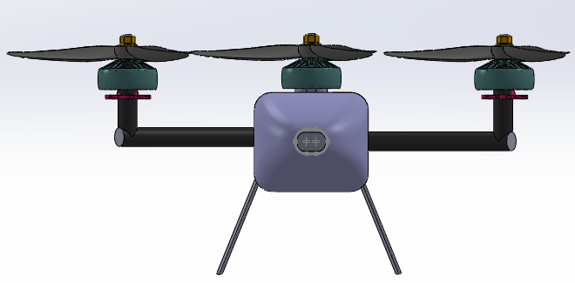
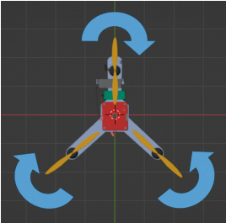
DESIGN - 1
Range : 20 km
Endurance : 1.5 hours
Tricopter Configuration : Y-shaped

Slide 4
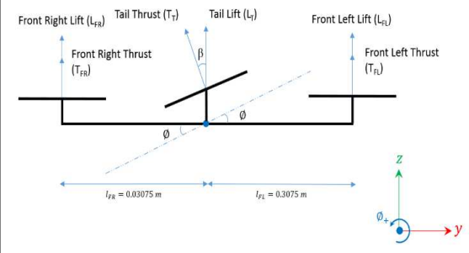
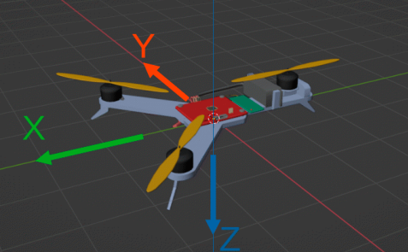
Physical Modelling
NED Coordinate system has been implemented
Assumption : Thrust forces and rotational moments generated by individual motors are proportional to the square of the motor speed values
Servo is used on the tail to balance the gyroscopic moments generated by the motor movements during operations.
Without servo the tricopter will rotate minimally around its axis while hovering
To balance all these the 2 remaining motors must rotate in opposite direction , shift the center of mass closer to the front of the tricopter such that large angle of deflection to the tail motor has been reduced
Source : Srigrarom, S , Wei Kang Teo, Jun Kheng Quek , Jing Jie Lim “Development of Flight Control for UGS Tri-Copter MAV”. Journal of Unmanned System Technology, UNSYS Digital, July 21, 2016.
Source : Salwa, M. ,Izabela Krzysztofik. “Optimal Control for a Three-Rotor Unmanned Aerial Vehicle in Programmed Flights”. Applied Sciences, 13(24), 13118. https://doi.org/10.3390/app132413118

Slide 5
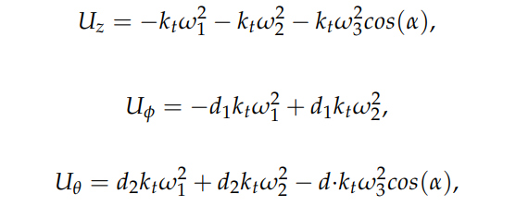



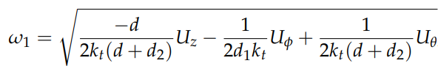





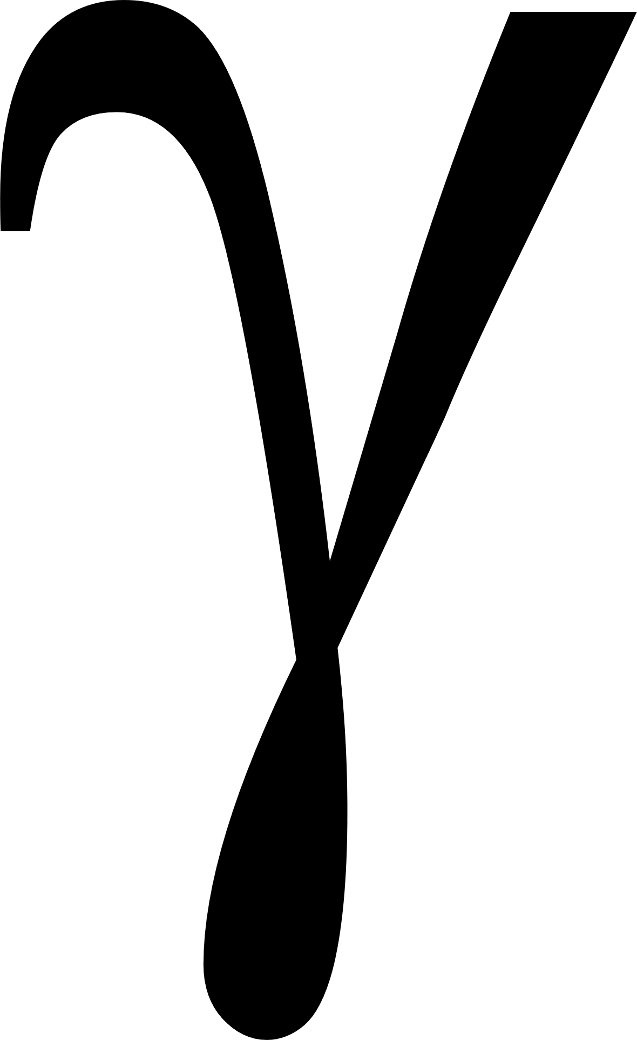

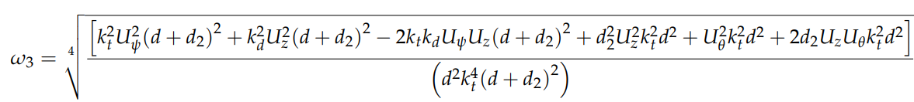
Physical Modelling
kt = Thrust coefficient
kd = Torque coefficient
alpha ( ) = angle of inclination of the tail motor
Uz = Thrust force
U = Rotation force around the x-axis
U = Rotation force around the y-axis
U =Rotation force around the z-axis
U = Force resulting from inclination of tail motor
= Motor Speed

Slide 6




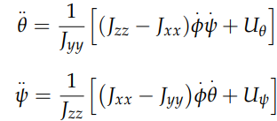
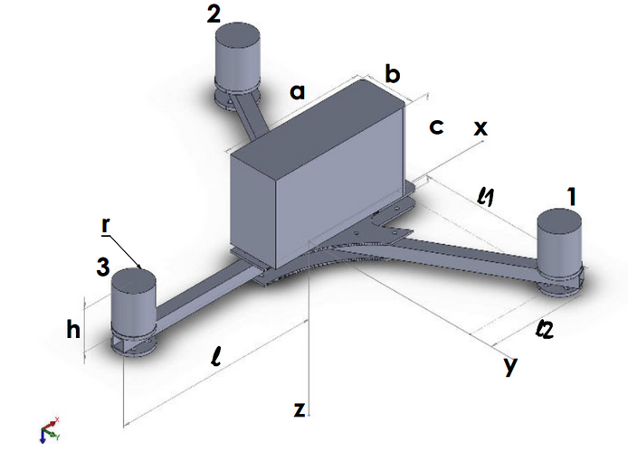
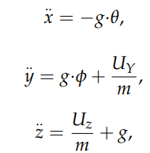
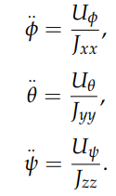
Mathematical Modelling
Equations of Motion (Non-Linear)
Linearised Translational EOM
Linearised Rotational EOM

Slide 7





Control System Architecture
Z
Attitude Control
Zd
Thrust (Fz)
Control Allocation
6 DOF Tricopter Dynamics
Roll
p
Roll rate
T
X-position
x-velocity
d
d
x
1
Vxd
2
Xd , Yd
Pitch
q
Pitch rate
T
d
y
3
y-position
Vyd
y-velocity
d
Yaw
r
Yaw rate
T
d
z
d
[p q r]`
[ , , ]`
[Vx , Vy , ]`
[x , y , ]`

Slide 8
Future Works
Completion of Simulink Model for the control system architecture
Simulate for different case scenario - Straight Flight , Infinity Loop (Figure 8 ) .
Performance Calculations using BEMT Code.

